Slide 1
Ch 4. The Market forces of Supply and Demand
Competitive market : Many buyers and many sellers, each has a negligible impact on market price
Perfectly competitive market: same goods. NO one can affect the market price… “Price takers”
Demand, or Quantity demanded
  Amount of a good that buyers are willing and able to purchase
Law of demand : Other things equal, when the price of a good rises, the
quantity demanded of the good falls, and when the price falls, the quantity demanded rises
Demand schedule & Demand curve(downward sloping)
Individual demand vs. Market demand
Demand curve shifters : Non-price determinants of demand
  Changes in them shift the D curve
  Caution!! Movement along(on) the curve vs. Shift of the curve
1. Number of buyers
2. Income
  Normal good: Increase in income leads to an increase in demand
  Inferior good: Increase in income leads to a decrease in demand
3. Prices of related goods
  Substitutes : Increase in the price of one leads to an increase in the demand of the other. Ex) Pizza and hamburger
  Complements : increase in the price of one leads to a decrease in the demand for the other. Ex) Bagels and cream cheese
4. Tastes
  Ex) Preference on SUV, Games, Foods….

Slide 2
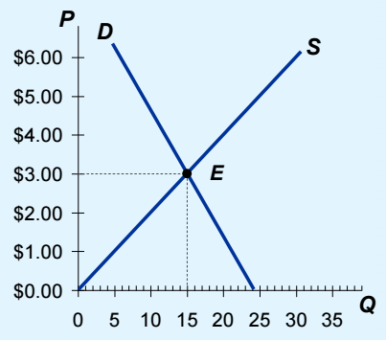
Supply, or Quantity supplied
  Amount of a good that sellers are willing and able to sell
Law of supply : Other things equal, when the price of a good rises, the
quantity supplied of the good rises, and when the price falls, the quantity supplied falls
Supply schedule & Supply curve(upward sloping)
Individual suppy vs. Market supply
Supply curve shifters : Non-price determinants of supply
  Changes in them shift the S curve
1. Input prices
  Supply is negatively related to prices of inputs. A fall in input prices makes production more profitable at each output price
2. Technology
  A cost-saving technological improvement has the same effect as a fall in input prices, shifts S curve to the right
3. Number of sellers
4. Expectation about future
  Sellers may adjust supply when their expectations of future prices change
Supply and demand together
Equilibrium:
  Price and Quantity
  Surplus
  Shortage

Slide 3
Three steps to analyzing changes in equilibrium
Decide which curve shifts,
and where to (right or left)
Use the diagram and compare the initial and the new equilibrium
Case study : Hybrid Cars Market
1. Increase in the price of gas → demand curve shifts
2. New hybrid cars technology → Supply curve shifts
3. If, both of them change at the same time → ??

